Slide 1
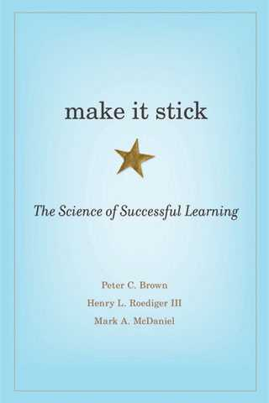
Make it Stick

Slide 2
Forgetting is useful
More assessment is the key to successful learning
We are poor judges of how well we are learning
Notes:
The controversial or counter-intuitive statements.

Slide 5
“Learning is a change in long-term memory.”
Paul Kirschner
Notes:
Agree that for the session we will take memory to mean learning since that’s what learning is; a physiological change in the brain. Mention Bloom’s Taxonomy and highlight that memory should not be thought of as the “remembering” segment.

Slide 6
Retrieval and Storage
Retrieval strength refers to how easily accessible learning is.
Storage strength refers to the depth of our learning.
Notes:
Retrieval – can you recall it consistently and fluently?
Storage – How well connected is the idea or concept to your other memories? What range of prompts can you associate with this learning? The good news is that storage strength is close to permanent; when we firmly embed an idea or concept, connecting it with our previous experiences, emotions and other memories, the quality of storage remains constant.
No matter how strong the storage, retrieval will fade over time if we don’t recall the information.

Slide 7
storage strength
high storage
low retrieval
high storage
high retrieval
retrieval strength
low storage
low retrieval
low storage
high retrieval
Notes:
How can a memory be high storage but have low retrieval? I struggled with this initially. If I ask you to name from memory 8 people from your P1 class, could you? Yet those people were a big part of your life. The reason you’ve forgotten their names is that you haven’t retrieved them much but your memories of them are still in there. As soon as someone digs out a picture the memories (and names) come flooding back.
Low storage, high retrieval – what did you have for lunch? You can retrieve it easily because not much time has passed but it’s going to fade from your memory unless you dedicate some effort to creating quality storage.
Low storage, low retrieval – what did you have for lunch on this day last year?
High storage, high retrieval – your subject knowledge. It is an interconnected series of concepts and theories that you regularly retrieve.

Slide 8
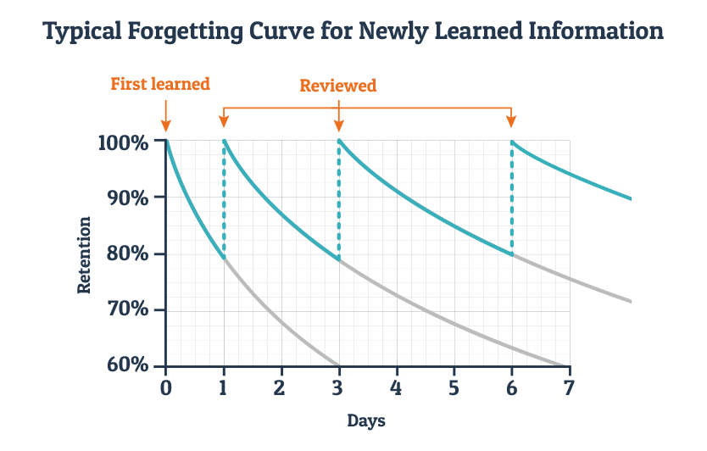
Notes:
So, why is forgetting useful? It is an inevitability that learners will forget most of what we teach them. That’s not because they’re ineffective learners or because we are ineffective teachers, it’s because learning means changing long term memory and changing long-term memory doesn’t happen instantly. Discuss the importance of sharing this with learners. Compare this with cramming

Slide 9
Maths

Slide 10
Regular, low-stakes assessment reduces the effects of acute stress on the brain during high-stakes assessment.
(Smith, Floerke & Thomas, 2016)

Slide 11
Takeaways on retrieval:
Forgetting is inevitable (and even desirable)
Spaced beats massed
Intervals should expand with time (and proficiency)
Low stakes assessment has many benefits

Slide 12
“Memory is the residue of thinking.”
Daniel Willingham

Slide 13
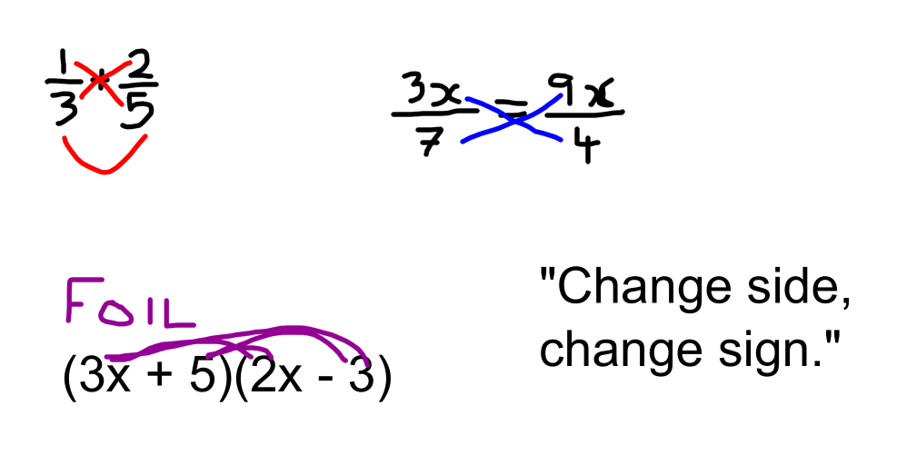

Slide 16
Multiple Representations

Slide 17
Interleaving
$$\frac{2}{3}+0⋅45 −20\%$$
$$\frac{3}{4}+2∙6 −32\%$$

Slide 18
Takeaways on Storage
Prioritise learning over performance – Nix the Tricks
Take a longitudinal view of learning
Interleave concepts to make the connections explicit
Ensure learners are exposed to problems in multiple formats
Notes:
The controversial or counter-intuitive statements.

Slide 19
Make it Stick
Lee Gray
Principal Teacher of Maths
St Mungo’s Academy, Glasgow
Twitter: @mrgraymath Email: l.gray@live.co.uk

