Slide 1
WOSIS Conference 25th May 2017
HAMILTON COLLEGE
Stakeholder Satisfaction
Mark Shields

Slide 2






Slide 3
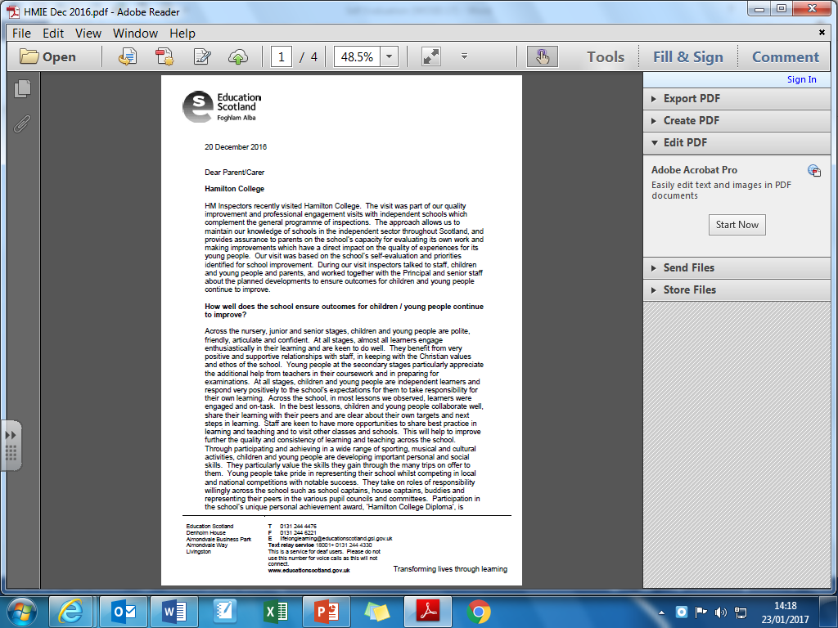

Slide 4
I am hoping you can help please-following the recent Maths prelim, ***** has said she will have definitely failed as she found the 2nd paper extremely hard, with questions in it she didn't know where to begin.
Would you be able to provide us with, say, 5 examples of the particular questions she didn't even attempt by tomorrow please? I believe the majority of the 2nd paper she couldn't do.
***** now has a Maths tutor and I know he will be very keen to look at the types of questions with her this weekend.
***** will be in tomorrow for her Business prelim until 10.45 - perhaps you could give them to her after that. Failing that, perhaps you could give them to her sister at some point during the day.

Slide 5
Evaluation of the Mathematics Department at Hamilton College
Please take time to complete this evaluation form thoughtfully with your son/daughter.
The responses will be discussed by the department and will be used to assist in improving learning and teaching.
The form relates to last year’s ****** Maths performance, with the questions pertaining solely to the Maths department and the Higher maths result achieved by your son/daughter.
S5 Maths Teacher:
(Please circle the correct responses here and elsewhere on this form)
Student: Male / Female 5A 5B 5C 5D

Slide 6
Section A – Final SQA Examination Performance
Please rate the following statements: low → high
My son/daughter performed as well as he/she could in their exam 1 2 3 4 5 6
My son/daughter achieved what they wanted with their final result 1 2 3 4 5 6
Overall my son/daughter was happy with their final SQA Maths result 1 2 3 4 5 6

Slide 7
Section B – Departmental Teaching
Please rate the following statements low → high
My son/daughter was pleased with their Maths teacher 1 2 3 4 5 6
My son/daughter had time to revise at the end of the course 1 2 3 4 5 6
The course was well taught 1 2 3 4 5 6
My son/daughter felt all topics were sufficiently covered 1 2 3 4 5 6
The prelim gave my son/daughter a useful guide to the final exam 1 2 3 4 5 6
My son/daughter was given the chance of extra assistance if required 1 2 3 4 5 6
Overall my son/daughter’s experience last year was a positive one 1 2 3 4 5 6

Slide 8
Section C
Please give suggestions for future improvement within the Maths department
…………………………………………………………………………………………………......
…………………………………………………………………………………………………......
…………………………………………………………………………………………………......
…………………………………………………………………………………………………......
…………………………………………………………………………………………………......
…………………………………………………………………………………………………......
Completed forms can be handed in to the front office or given to any member of the Maths department.
Closing date for returns is Wednesday xxxxxx

Slide 9
Name: S1 Maths – October Test
Paper 1 (non-calculator)
Outcome 1: /10
Outcome 2: /20
Outcome 3: /10
Total: /40 %
Paper 2 (calculator)
Outcome 1: /10
Outcome 2: /20
Outcome 3: /10
Total: /40 %
Overall Score /80 %
The exam papers are split into three outcomes with each section becoming more difficult. Outcomes 2 and 3 contain more questions that involve applying mathematical knowledge.
Areas that I need to revise/Mistakes I made:
See attached sheet which pupils should have highlighted questions to revisit
Parent’s Signature:
Please feel free to comment

Slide 10
Question | Area to revise | Questions
1 | Multiplying and dividing by multiples of 10 | Pg 9 Ex 1.4 Q1,2 Pg 10 Ex 1.5 Q1,2
2 | Rounding to 1 & 2 decimal places | Pg 7 Ex 1.2 Q1
3 | Dividing by multiples of 10 in “real-life” situations | Pg 9 Ex 1.5 Q6,8
4 | BODMAS (Order of Operations) | Pg 14 Ex 1.8 Q1,2
5 | Prime factors | Pg 22 Ex 2.4 Q2
6 | Sequences | Pg 18 Ex 2.1 Q2,5
7 | Squares and Cubes | Pg 22 Ex 2.5 Q1,8
8 | Completing symmetry pictures | Pg 29 Ex 3.3
9 | Multiplying by 2 digit numbers | Pg 12 Ex 1.6
10 | Highest common factor and lowest common multiple | Pg 20 Ex 2.2 Q5,11,12
11 | Division in “real-life” situations | Pg 16 Review Ex 1 Q7,8
12 | Rotational symmetry | Pg 32 Ex 3.6

Slide 11
Name:
Paper 1: Paper 2: Overall: %
S3 October Test – N5 Paper 1
Difficulty with Topic | What I did wrong……. | What can I do to improve this?

Slide 13
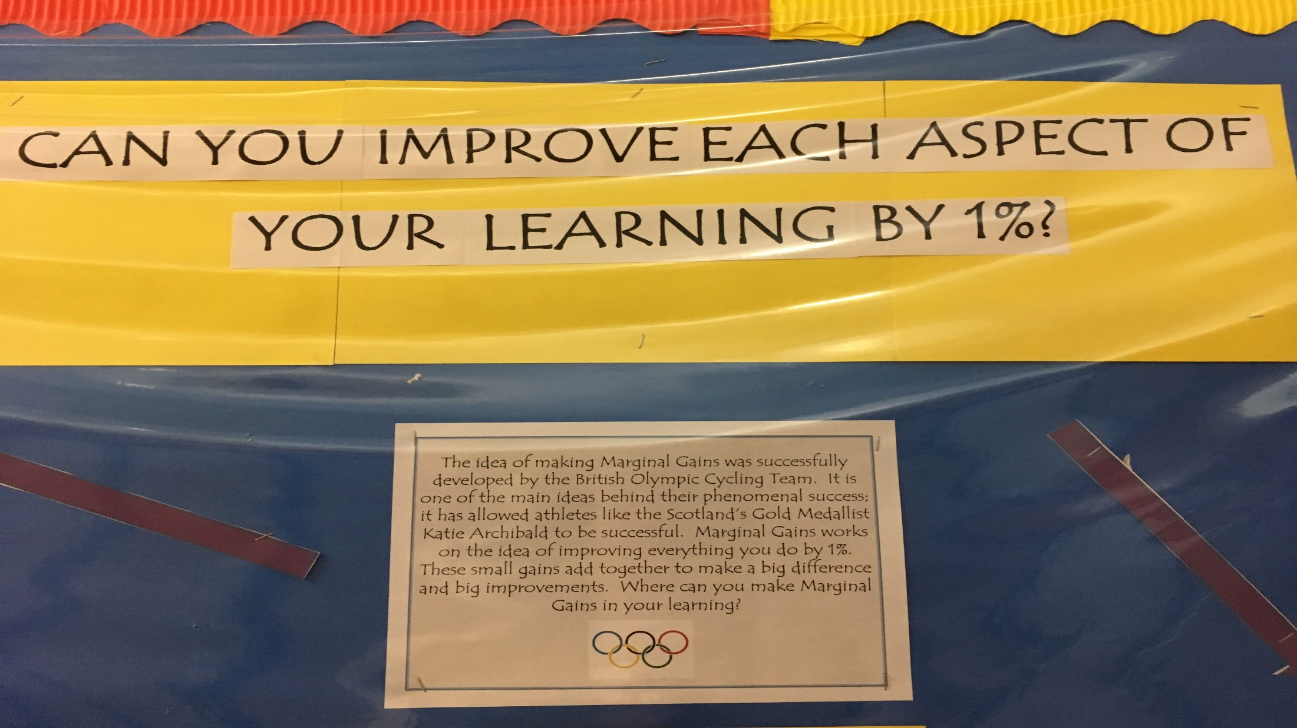

Slide 14
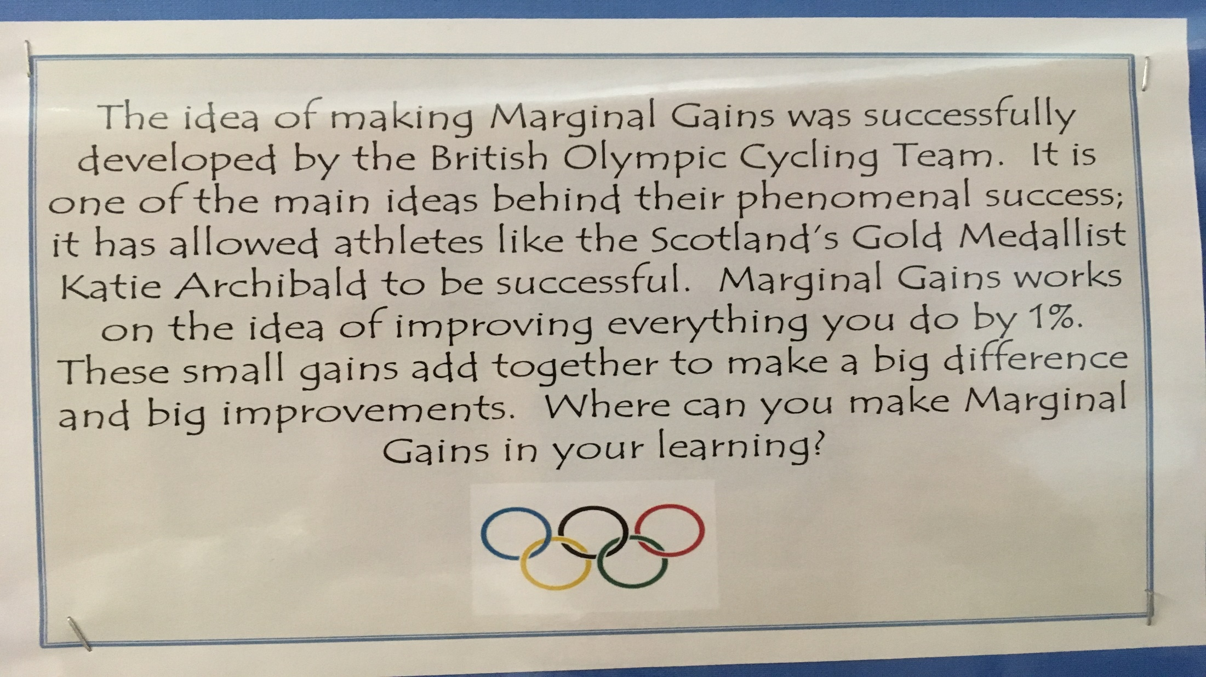

Slide 15
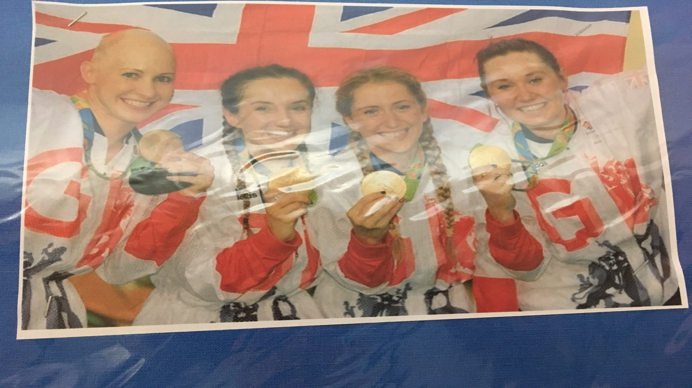

Slide 16
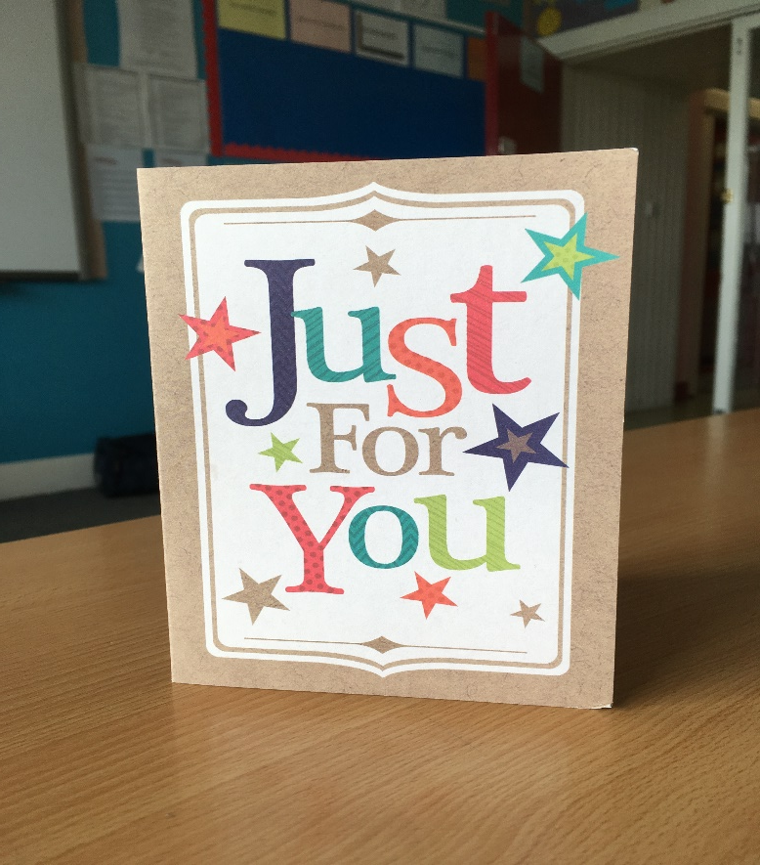
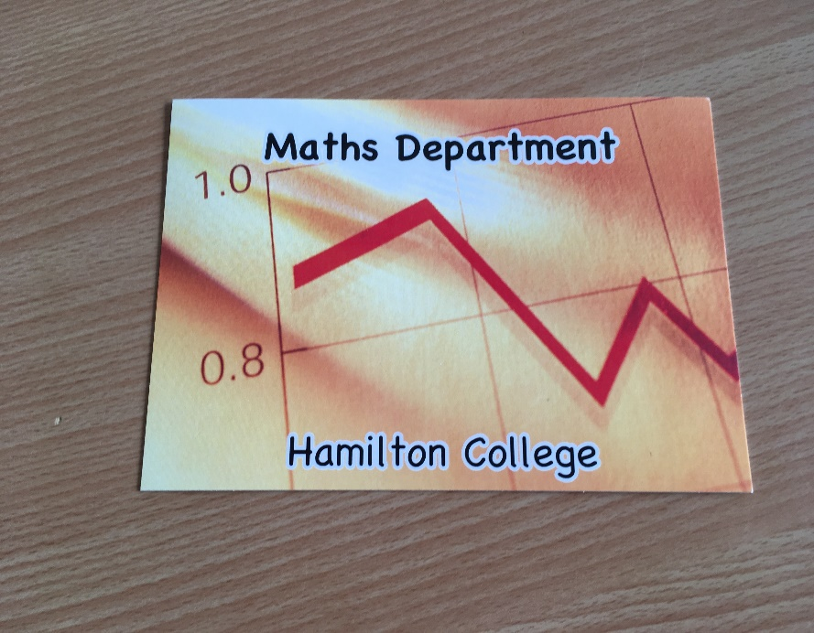

Slide 17
‘You can please some of the people all of the time, you can please all of the people some of the time, but you can’t please all of the people all of the time’.
John Lydgate

Slide 18
I am hoping you can help please-following the recent Maths prelim, ***** has said she will have definitely failed as she found the 2nd paper extremely hard, with questions in it she didn't know where to begin.
Would you be able to provide us with, say, 5 examples of the particular questions she didn't even attempt by tomorrow please? I believe the majority of the 2nd paper she couldn't do.
***** now has a Maths tutor and I know he will be very keen to look at the types of questions with her this weekend.
***** will be in tomorrow for her Business prelim until 10.45 - perhaps you could give them to her after that. Failing that, perhaps you could give them to her sister at some point during the day.

Slide 19


