Slide 1
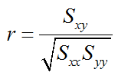
Higher Statistics Award
SCQF Level 6
Special Interest Course.
Recommended entry requirement, N5 in Mathematics or Sciences
Statistical Literacy
Software Package – Minitab

Slide 2
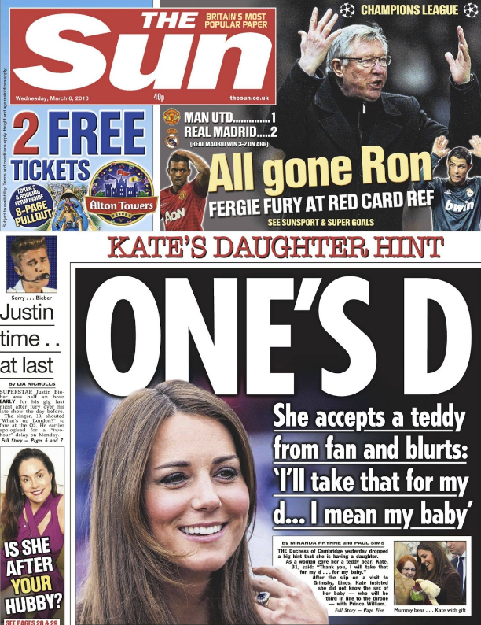
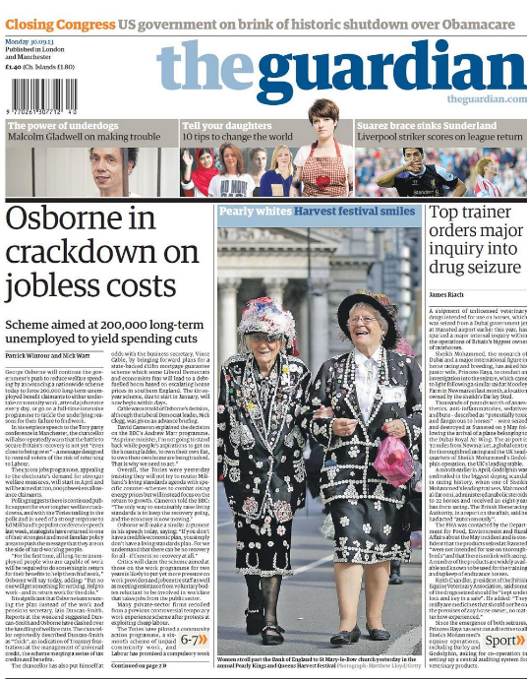
Stylometry
Study of the measurable features of literary style.
Open ended, practical exercise.
Sampling
Google Library + Big Data

Slide 3
Case Study Approach – Measures of Location and Spread
Normal Distribution
Blood pressure, Height, Errors, IQ Galton Box
Skewed Data
House prices, Scottish Census Data
Minitab

Slide 4
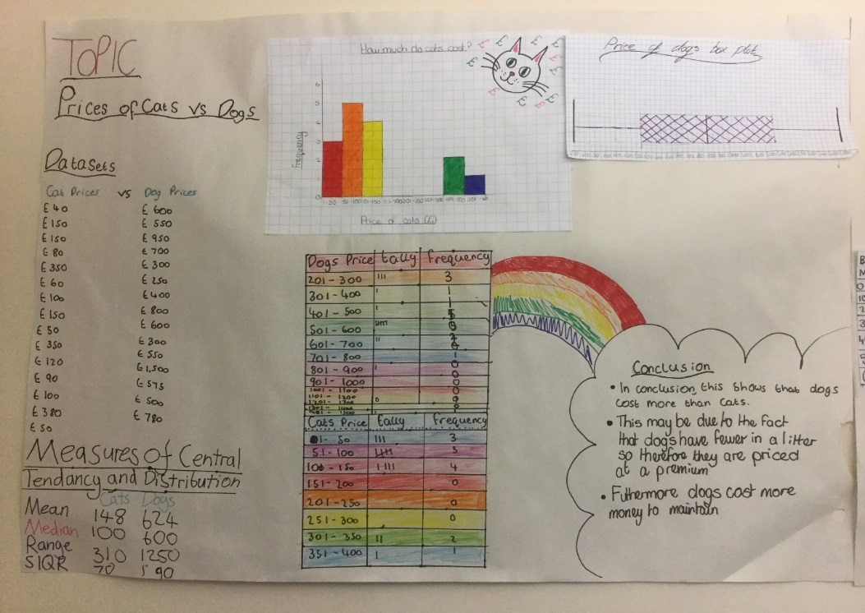
Hypothesis Testing
Ebola Vaccine, three out of the first five patients recovered.
Would you take the untested vaccine?
Price of Cats vs Dogs, is it significant?
“Are two heads better than one?”

Slide 5
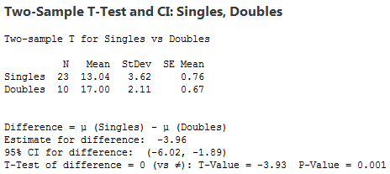
Are two heads better than one?

Slide 6
Linear Regression
Coefficient of Determination, Pearsons Correlation Coefficient
Case studies Foetus Length and Gestational Age
Politics Yes/No votes and housing/environment/income
Minitab Coefficient of Determination
Pearsons Correlation Coefficient
p-value

Slide 7
Investigations – Pupil’s Work
Open ended
Showcase skills, pursue own interests, presentation and persuasion.
Broader range of statistical tests.
Deeper understanding of the course content.

Slide 8
Assessment
Unit Assessment
Cross-curricular links.
Resources Dr David Young Strathclyde University
SQA and Minitab Labs
Notes and formal homework.
SIMD, Scottish Census, flightradar, Cancer Research, UCLA database Atlantic Slave trade, Minitab Cookbook Andy Field, RSS teacher membership.

Slide 9
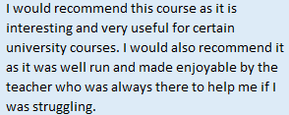
Pupil Feedback
Would you recommend this course to a friend?

