Slide 2
Blended learning

Slide 3
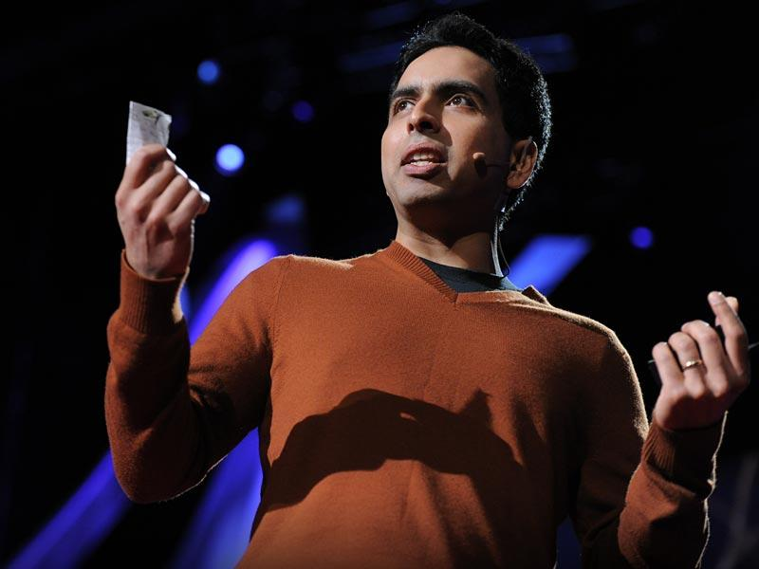

Slide 4
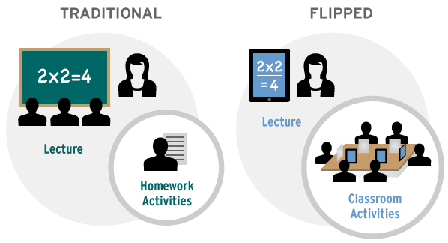

Slide 5
Flipped classroom – explained
https://youtu.be/iQWvc6qhTds

Slide 6
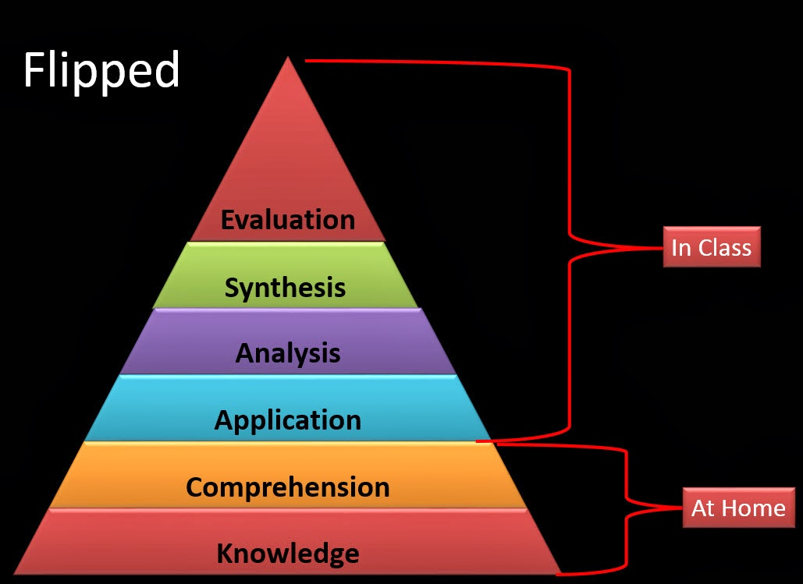

Slide 11
Absence
Pace
Teacher time
Revision
Split level

Slide 12
“It’s easier than in class. In class there’s other people and distractions. At home it’s just me and you.”

Slide 13
“I’m really busy through the week with hockey. It’s great that I can watch next week’s videos at the weekend so I don’t fall behind.”

Slide 14
“It’s really well explained.”

Slide 15
“I feel like I can set my own pace.”

Slide 16
“In my IGCSE we didn’t do any Trig graphs or Trig without a calculator. Watching the videos has helped me to catch up.”

Slide 17
“All school should be taught like this.”

Slide 18
Access
How to watch/interact
Not too long
Perfection
Start small

Slide 19
They don’t watch
No internet access
No time to make videos

Slide 20
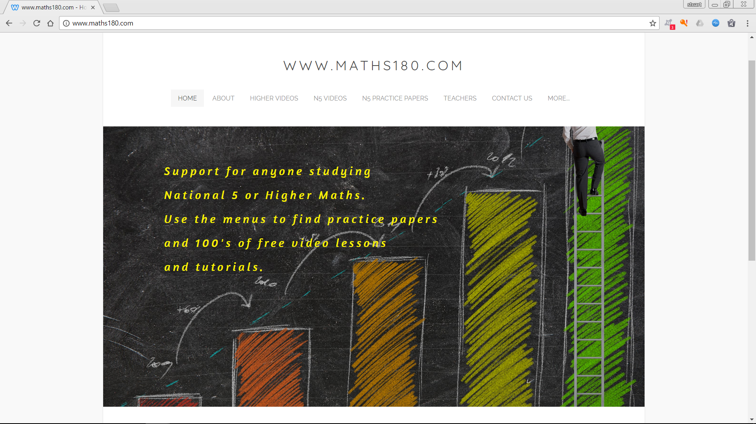

Slide 21
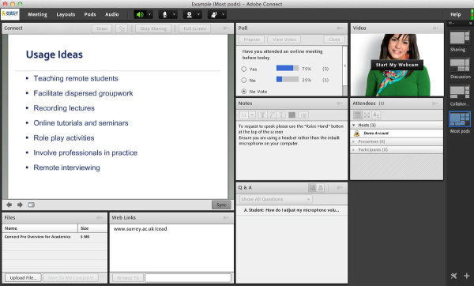
Adobe Connect
Teaching remote students
Facilitate dispersed group-work
Recording lectures
Online tutorials and seminars

Slide 22
Resources
Maths180 (N5 and Higher video tutorials): www.maths180.com
Dan Mayer (Blog and TED talk): www.blog.mrmeyer.com/ https://www.ted.com/talks/dan_meyer_math_curriculum_makeover
Khan Academy (online instructional videos): www.khanacademy.org
Coursera (online course directory): www.coursera.org
Socrative (real-time formative assessment): http://www.socrative.com/
Snagit (screen capture software): www.techsmith.com/snagit.html
WACOM (Graphics tablets): www.wacom.com
Weebly (website builder): www.weebly.com
Blended Learning Universe: www.blendedlearning.org/
CK12 (online STEM teaching resources): www.ck12.org
Flipped Learning Network: www.flippedlearning.org/
http://www.scottishmathematicalcouncil.org/wp1/smc-publications/journals/ (Journal 46)

