Slide 1
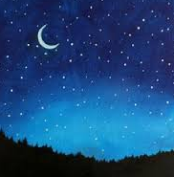
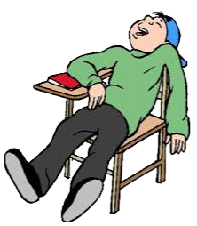
Sleep and the Teenage Brain
Jennifer Ritson
Notes:
Me – Maths teacher and Guidance. Exposed to health, emotional and social training – informs my teaching in the classroom.

Slide 2
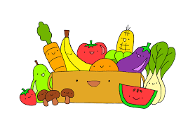
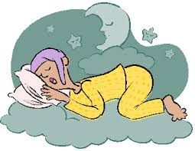
Why look at sleep?
Health and Wellbeing:
Diet
Exercise
Habits
Mental Health
Sleep Health
Why look at sleep?
Notes:
Health and Wellbeing responsibility of all.
Health – all confident discussing dietary, physical, habits and now mental, but not sleep health which effects each of these. Adolescents with 5 or fewer hours of sleep per night 71% more likely to be depressed and 48% more likely to think about suicide than those with 8 hours sleep per night. Research by Harrison and Martin, 2010. 2015 556 suicides, 191 traffic accidents (National Records of Scotland).
Many people with sleep issues – study by Sleep Scotland (2013-2015) of 785 teenagers:
Only 19% felt satisfied with their sleep every night.
34% said they had an extremely hard time falling asleep almost every night.
50% said they felt tired or dragged out nearly every day.
Health implications and effects on memory and your ability to retain information – a major problem if you are a teenager trying to learn.
1998 survey – students with higher grades reported more total sleep. Failing students (C-F) slept around 25 mins less and in bed 40 mins later than A/B students.

Slide 3
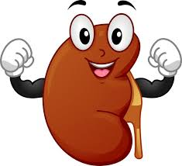
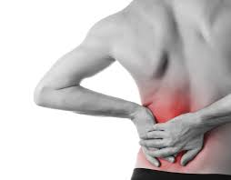
What happens when you sleep?
Sleep is an active period:
Restoration
Strengthening
Processing
What happens when you sleep?
Notes:
Sleep is an active period (known for ≈ since 1920s)
Restoration
Strengthening
Processing
Restore and rejuvenate, repair tissue
Grow muscle and synthesize hormones.
During the day our brains take in an extraordinary amount of information (acquisition). This information needs to be processed and stored. Most happens when we’re asleep. Information is transferred from short-term memory to stronger long-term memory in a process called consolidation. Once stored we can access the information (recall).

Slide 4
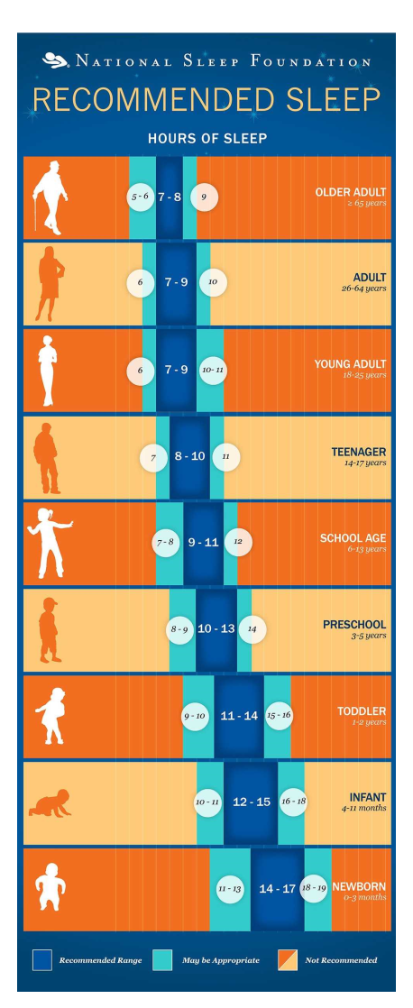
How much
sleep do we
need?
How much sleep do we need?
Notes:
Note reduces as we get older. Upper limit as well as lower limit – no benefit beyond, may even damage

Slide 5
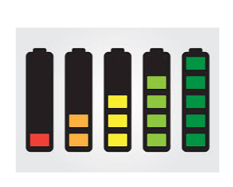
Notes:
Show battery charger. If not full will work, if full will not charge any more.

Slide 6
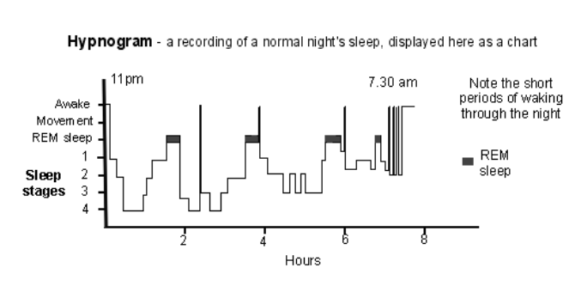
The sleep cycle.
The Sleep Cycle.
Notes:
Infants 50 mins – adults 90 mins

Slide 7
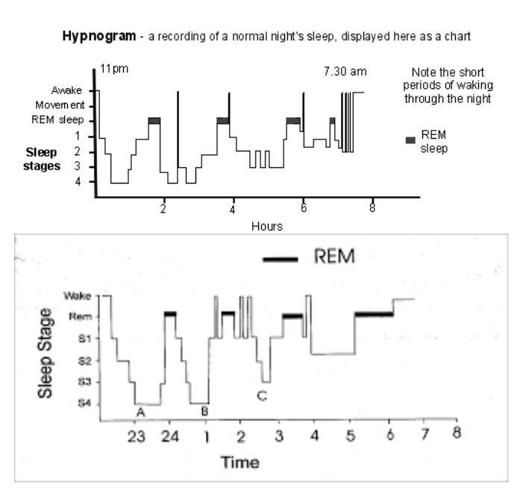
The sleep cycle.
Notes:
Teenagers have similar patterns to adults but longer REM – talk about in a minute.
Thousands of neurons created to form memories. Thought sleep was for rebalancing until EEGs invented in 1920s. Rebalancing occurs when awake in order to focus on memory processes when we’re asleep
Rapid eye movement (REM) consolidate procedural memory (movement and physical knowledge). Teenagers learning to move again – growth spurts – so need more.

Slide 8
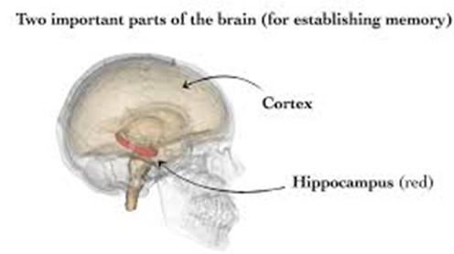
The sleep cycle.
Notes:
Slow-wave sleep (deep sleep) when we consolidate declarative memory (verbal knowledge and facts). Also electrical input from the hippocampus (small region involved in emotion and memory) reaches the cortex (outer layer linked to consciousness, learning and memory) allowing the consolidation of recent memories to long-term memories.

Slide 9
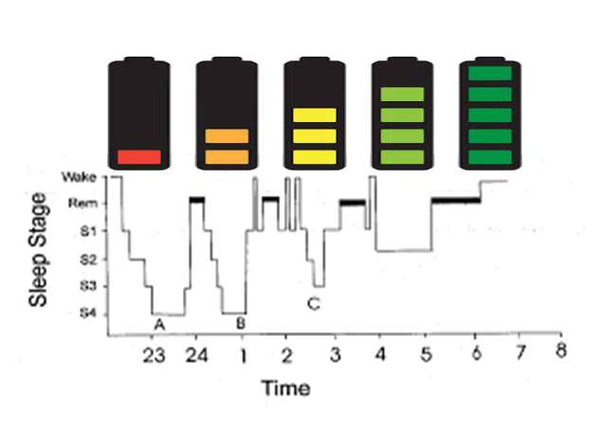
The sleep cycle.
Notes:
Battery charger with scale. If not fully charged will function but may have missed full cycle.

Slide 10
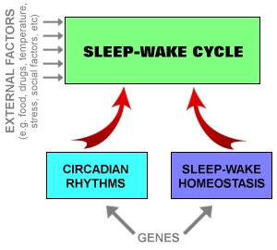
Why do we fall asleep?
Two Processes:
Sleep-Wake Homeostasis
Circadian Rhythm
Why do we fall asleep?
Notes:
Sleep-wake homeostasis. An internal biochemical system that increases the pressure to sleep the longer you’ve been awake.
Circadian Rhythm. Your body clock which tells you to do certain things at certain times like eating and drinking (and going to the toilet at break time) and controls core body temperature. Regular routines help to set the body clock. The Circadian Rhythm relies on hormones:

Slide 11
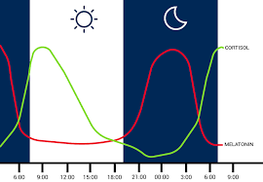
Circadian Rhythm.
Hormone Release:
Growth hormone
Cortisol
Melatonin
Circadian Rhythm.
Notes:
Growth hormones, Cortisol, Melatonin
Melatonin and Cortisol control sleepiness and wakefulness.
Cortisol is the wake-up hormone and is produced by daylight and stress and anxiety.
Melatonin is the sleep hormone and production is helped by the body clock.
In good balance cortisol and melatonin work together to create a good sleeping pattern.
In teenagers the melatonin production shifts by about 2 hours so not tired until later. They can go to bed but without resetting their body clock will not sleep until later so 9 ¼ hours not possible. Effectively jet-lagged at school. Trying to “catch-up” at the weekend disturbs cycle and makes things worse.

Slide 12
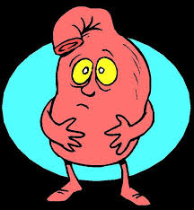
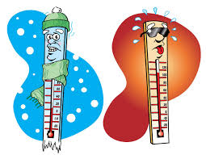
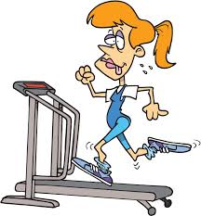
What stops us sleeping?
Irregular bedtimes/oversleeping at weekends
Caffeine or sugar
Alcohol, nicotine or drugs
Too full or too hungry
Too hot or too cold
Too light
Strenuous exercise too late
Stress/anxiety
The biggy…
What stops us sleeping?

Slide 13
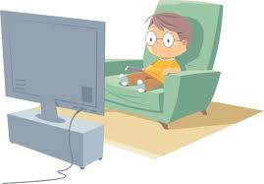
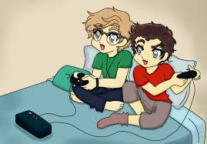
What stops us sleeping?
Notes:
Old computer and TV screens had lots of red. They were bad but not as bad as now. Remember, daylight produces cortisol.

Slide 14
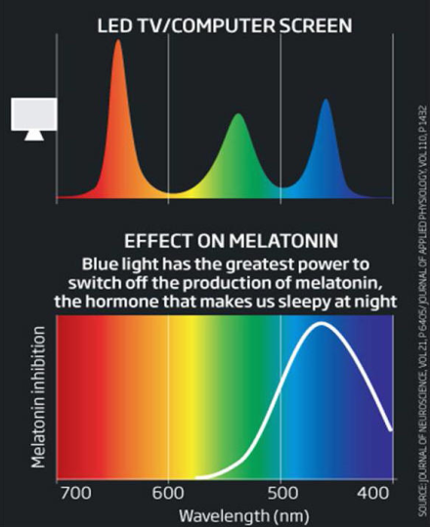
What stops us sleeping?
Notes:
Modern screens emit light which peaks in the cortisol range – your body thinks it’s still day.

Slide 15
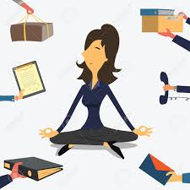
How to improve sleep.
Daytime changes:
Expose yourself to natural light for at least 30 minutes
Avoid too many caffeine drinks
Deal with causes of stress
Avoid napping
How to improve sleep.

Slide 16
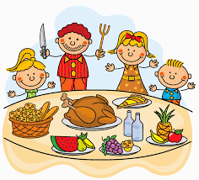
How to improve sleep.
Evening changes:
Eat well with time to digest
Clear pending tasks
Perform stimulating tasks earlier
Avoid alcohol
Avoid nicotine products
Notes:
pending tasks – homework (marking)
stimulating activities – exercise, computer games, watching TV
alcohol should be avoided within 6 hours of going to bed

Slide 17
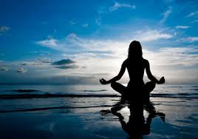
How to improve sleep.
Just before bed:
Try to prepare psychologically and physically for sleep.
Notes:
aim to leave the day behind, prepare for the onset of sleep and set your body clock.

Slide 18
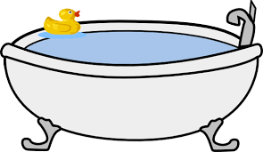
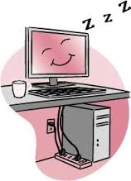
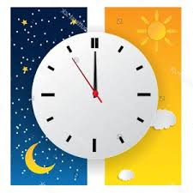
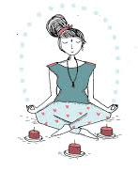
How to improve sleep.
The last hour:
Switch off anything with a screen.
Have a bath, wind down, relax.
Read or listen to relaxing music.
Stick as closely as possible to regular bedtimes and waking times.
Use relaxation techniques to help you drift off to sleep.

Slide 19
References.
Sleepfoundation.org
Brainblogger.com
Sleepscotland.org
References.
Notes:
Particular mention to Sleep Scotland, great organisation offering courses for teachers and students. Sound Sleep education programme.

Slide 20
Questions?
Questions?

