Slide 1
Using Tarsia Puzzles
Gordon Stevenson,
Belmont House School

Slide 2
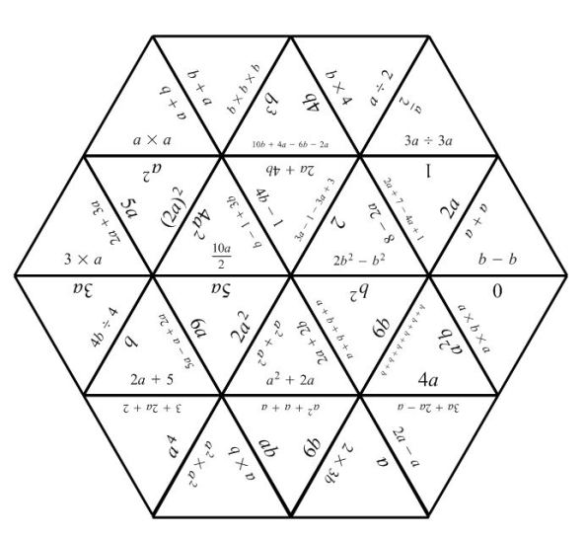
Picture of a completed tarsia puzzle

Slide 3
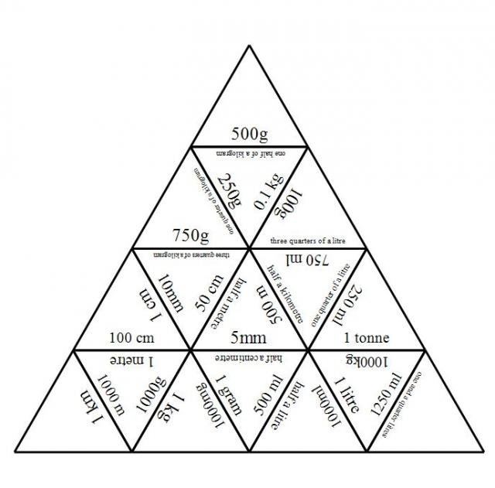
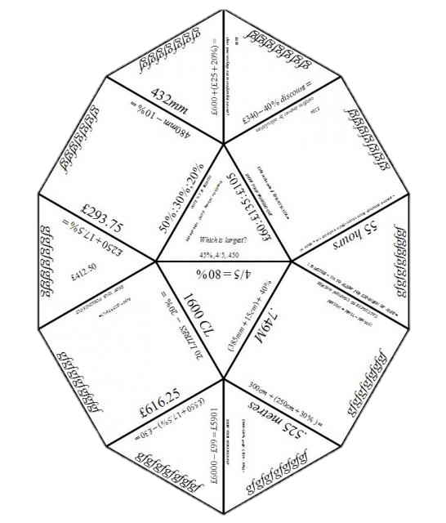
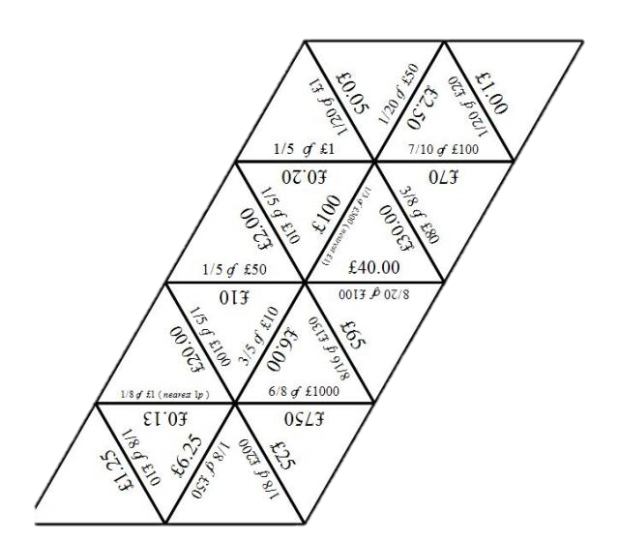

Slide 4
Hermitech Laboratories
Founded in Ukraine in 2003 to develop mathematical software tools.
Notes:
Screen shot of table mode

Slide 5
V
i
s
u
a
l
A
u
d
i
o
R
e
a
d
i
n
g
K
i
n
e
a
s
t
h
e
t
i
c
Why?
Individual Paired Group
Self-Checking
Notes:
Why I use tarsia puzzles? Preferred learning styles and preferred working practice.

Slide 6
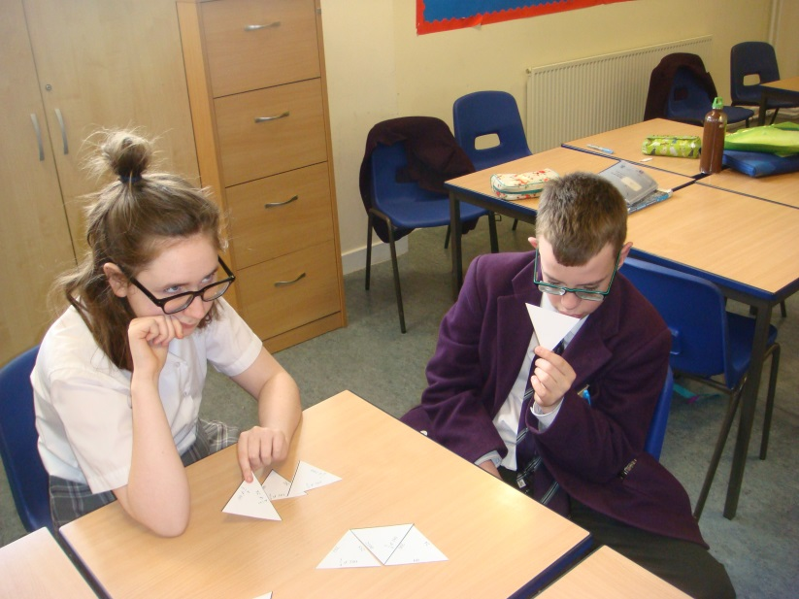
Quality of Written Communication
Problem Solving Skills – Resilience
Teamwork
Notes:
Can they explain their maths to others. Develop problem solving skills.

Slide 7
Tarsia Rules
Cards are shared equally between group members.
Group members take turns to select the question to be tackled by the group.
Students must explain their answers to the rest of the group.

Slide 8
Differentiation
Blank edges.
No edges – spurious questions/solutions
Answer appears more than once.
Create their own.

Slide 9
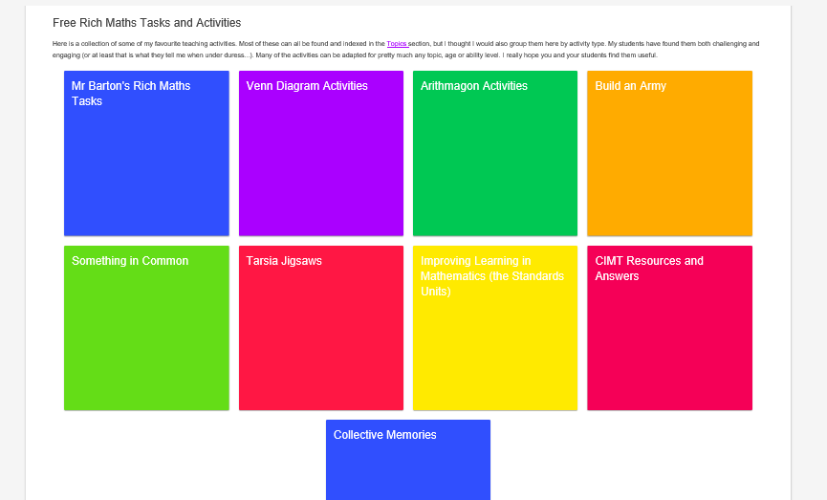
mrbartonmaths.com/teacher/rich-tasks

Slide 10
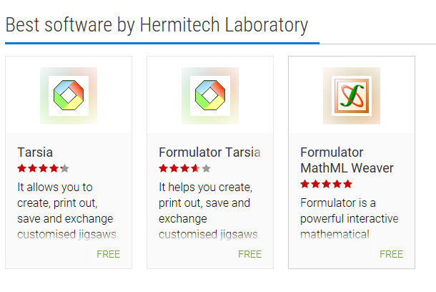
hermitech-laboratory.software.informer.com
Notes:
Tarisa – read puzzles only, allows you to print. Formulator – allows you to create your own

Slide 11
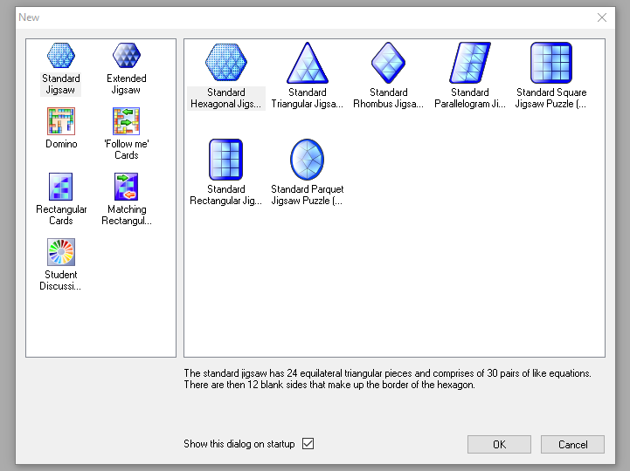
Notes:
Choice of shapes and sizes

Slide 12
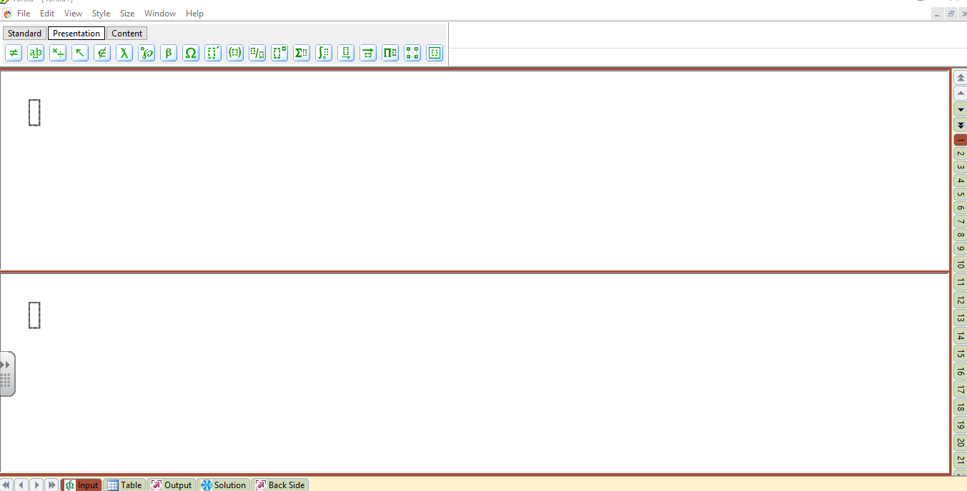
Notes:
Toolbar – fractions, roots, indices, integrals etc

Slide 13
Other Activities
Domino chains – sequencing of multi-step calculations
Treasure Hunts/Maths Trails
Notes:
Domino chains – Q & A or sequencing tasks. Treasure Hunt – same idea but around the walls of the classroom.

